Slide 1

FACULTY OF MANAGEMENT STUDIES Mohanlal Sukhadiya University, UDAIPUR
Environment And Management
Assignment
Submitted by:
Prerna Bhati Ma’am

Slide 2

Environmental Auditing and Clearance or permission for establishing an industry

Slide 3

CONTENTS
ENVIRONMENTAL AUDIT
What is an audit ?
Introduction
Objectives of environmental audit
Benefits of environmental audit
CLEARANCE & PERMISSIONS FOR ESTABLISHING AN INDUSTRY
What is an industry?
Meaning of clearance
Procedure for clearance

Slide 4


Slide 5

What is an Audit?
The term ”audit” is very generic word ,it essentially means to examine something thoroughly.

Slide 6

Environmental Auditing
Environmental auditing is a management tool which simply inspects the environmental management activities performed by the industries or orgsanisations and makes them aware of new cleaner technology.
For the impact of industries and their product on natural resources and environmental quality it is necessary to have “Environmental Audit” to ensure sustainable industrial development

Slide 7

Objectives Of Environmental Audit
To serve to achieve compliance standards and establish a report with regulatory bodies
To review the implementation of policies
To identify needs , strengths and weaknesses
To assess environmental performance
To promote environment awareness
To reduce waste
Improve risk management system
To identify liabilities

Slide 8

Benefits Of Environmental Audit
FINANCIAL BENEFITS
Helps avoid fines by regulatory agencies
Identifies issues of non compliance sooner versus later allowing for proactive financial planning lowers corrective action costs
Waste minimization opportunities realized , leading to reduced operating costs
COMPLIANCE BENEFITS
Reduced agency enforcement actions penalties
Increased employee awareness of environmental standards and responsibilities

Slide 9
STAKEHOLDER RELATIONS BENEFITS
Improved employee relations and increased morale
Improved community image of the company goodwill
GENERAL BENEFITS
Maintenance of sustainable level of development

Slide 10
CLEARANCE & PERMISSIONS FOR ESTABLISHING AN INDUSTRY

Slide 11
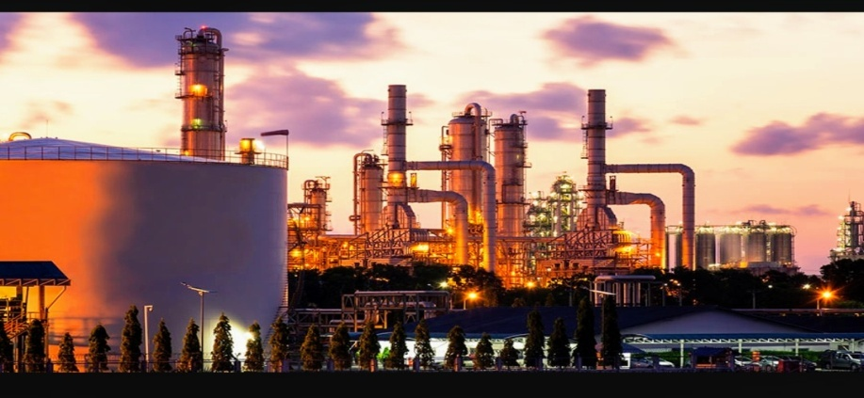
What is an Industry?
An Industry is a group of manufactures or businesses that produce a particular kind of goods or services.
For example: Cotton Industries, Automobile Industries etc.

Slide 12

Meaning of Clearance
CLEARANCE REFERS TO:
Authorization or permission from an authority
Permission to proceed
Official authorization for something to proceed or take place.

Slide 13
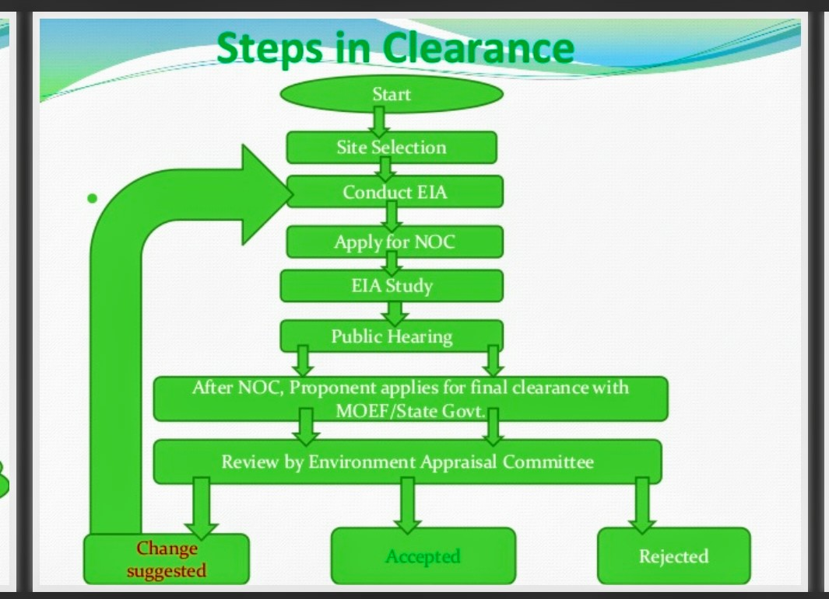

Slide 14

REFERENCES
Environmental management , NK Uberoi
https://www.scribd.com/presentation/201931129/Presentation-on-Clearances
https://www.slideshare.net/mobile/natthushrirame/environmental-auditing-ppt

Slide 15

Thank you

